Slide 1
MEDICATION DEPRESCRIBING WITH REMISSION OF TYPE 2 DIABETES
Sean McKelvey, BSc(Pharm), CEO
November 28, 2023

Slide 2

DISCLOSURES
No financial disclosures
Other
  The IPTN has no financial ties to the food industry
  We do NOT accept funding from for-profit companies
Dietary declaration:
  Omnivore – plant forward
  Low sugar, low starch
  Time restricted eating (16:8)
  3-4 cycles of a ketogenic diet per year
  No counting, no weighing
  Vices: beer and pie

Slide 3

IPTN CHARITABLE PURPOSES
  Raise public awareness of therapeutic nutrition (TN) and help people adopt the approach
  Train and certify health care providers to safely support and/or deliver TN
  Research best ways to deliver TN and share new knowledge with the public and health care providers

Slide 4

CHANGING THE CONVERSATION
Raise awareness that type 2 diabetes remission is possible
Offer multidisciplinary training programs
Coordinate an international network of Universities
Support the updating of curriculum for University based health profession programs
Position remission as a potential clinical option for patients
Give patients renewed hope

Slide 5
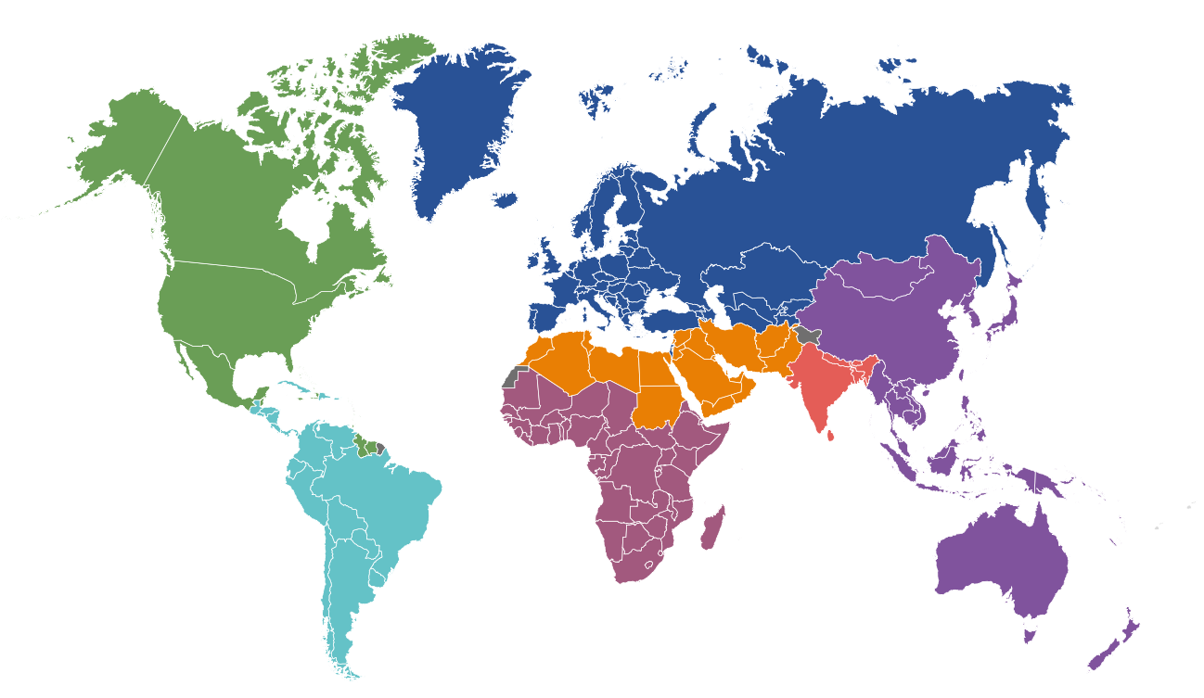
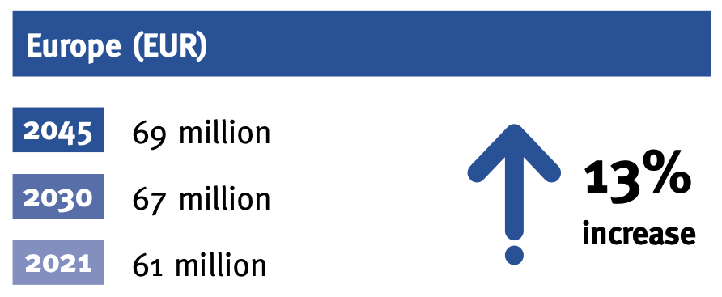
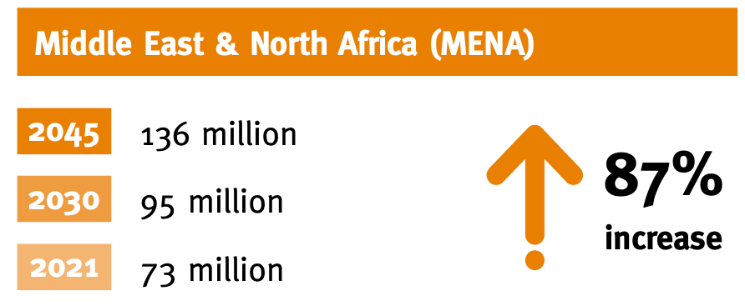
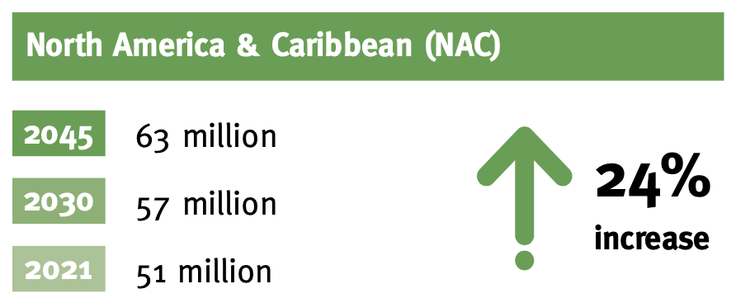
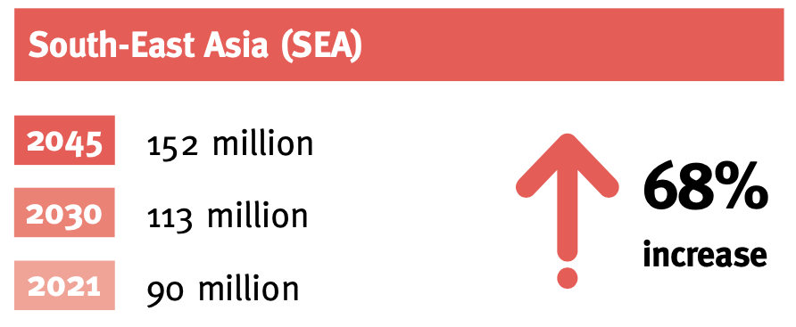
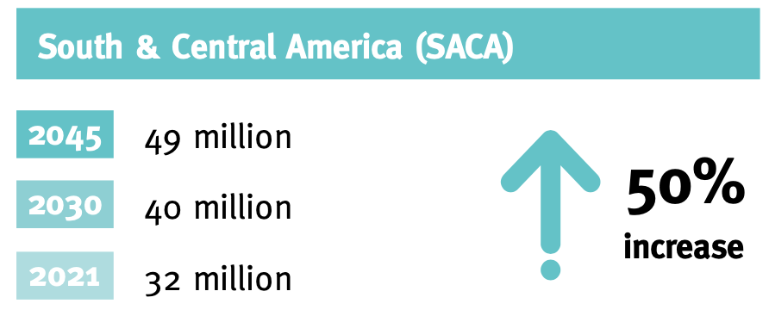
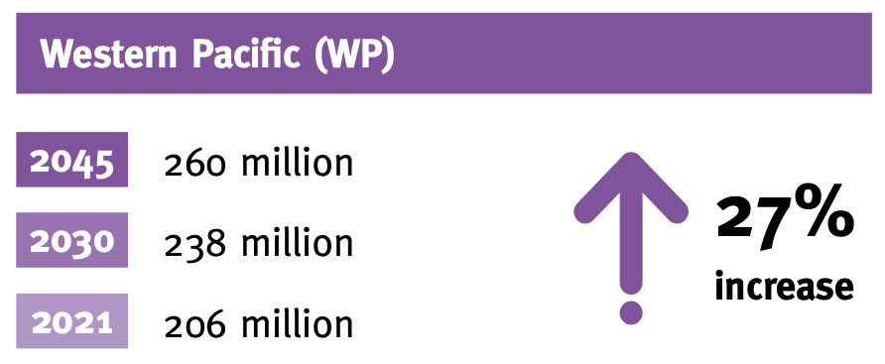
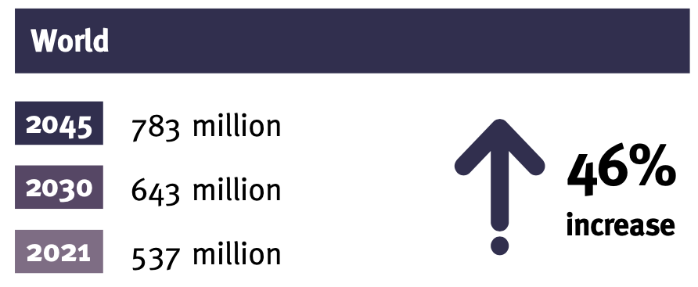
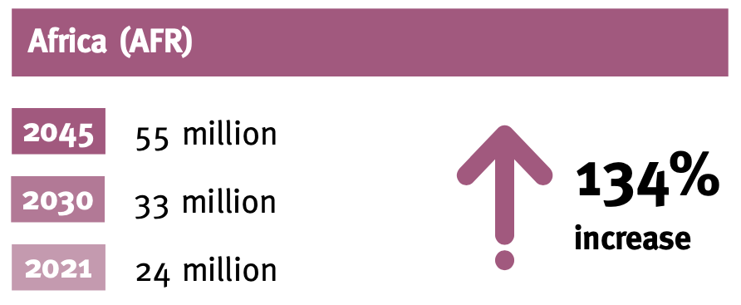
DIABETES PROJECTIONS (2021 to 2045)
International Diabetes Federation Diabetes Atlas 2021

Slide 6
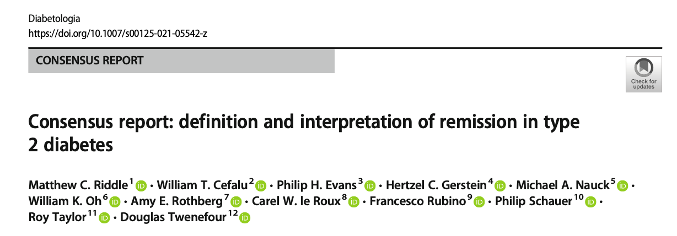
REMISSION DEFINITIONS
Diabetes Canada
Remission to prediabetes
  HbA1c between 6.0 and 6.4%
  Off all glucose lowering medications for >3months
Remission to normal glucose concentration
  HbA1c <6.0%
  Off all glucose lowering medications for >3months
ADA/EASD
HbA1c <6.5%
Off all glucose lowering medications for >3months
Aug 30, 2021

Slide 7
TYPE 2 DIABETES REVERSAL/REMISSION EVIDENCE
TYPE 2 DIABETES REVERSAL/REMISSION EVIDENCE
 |  |  |  |  |  |  |  | % Reversal/Remission
# | Trial | Trial Design | Intervention | CHO | n | Years with T2D | Insulin | 1 yr | 2yr | 5+yr
1 | DiRECT (2019) | Cluster Randomization | LED (Total MR) | 110-125g | 158 | <6y | NO | 46% (86% >15kg) | 36% (70% >15kg) | 13%
2 | Virta (2019) | Non Randomized | LCKD (BHB > 0.5mmol/L) | <30g | 262 | 8.4y | YES | 60% -HGM | 54% -HGM | 20% R (n~130)
3 | DIADEM-I (2020) | RCT | LED (Total MR) | 110-125g | 147 | <3y | NO | 61% | NA | NA
4 | DiRECT-Aus (2023) | RCT | LED (Total MR) | <70g | 155 | 2.8y | NO | 56% (87%>15kg) | NA | NA
5 | UBC Pharm-TCR (2021) | RCT | LED+LCKD (Partial MR) | <50g | 188 | 11.8y | YES | 17% (12 weeks) | NA | NA
6 | LSI Study (2019) | Non Randomized | LSI | NR (ADA 2011) | 45 | 1.9y | YES | 53% P 18% C | NR | 27% P 19.5% C
7 | Mediterranean Diet (2014) | Randomized | LCMD | 188 - 225g | 108 | <1y | NO | 14.7% P | 10.5% P | 5% P (6y)
8 | Diabetes & Aging Study (Kaiser - 2014) | Retrospective Cohort | Usual Care | NR | 122,781 | 5.9y | YES | 1.47% P 0.14% C | ? | 0.007% (7y)
LCKD = Low Carb Ketogenic Diet LED = Low Energy Diet LSI = Multiple Lifestyle Intervention LCMD = Low Carb Mediterranean
C = Complete Remission P = Partial Remission NR = Not Reported HGM = Hypoglycemic Medications MR=Meal Replacement

Slide 8
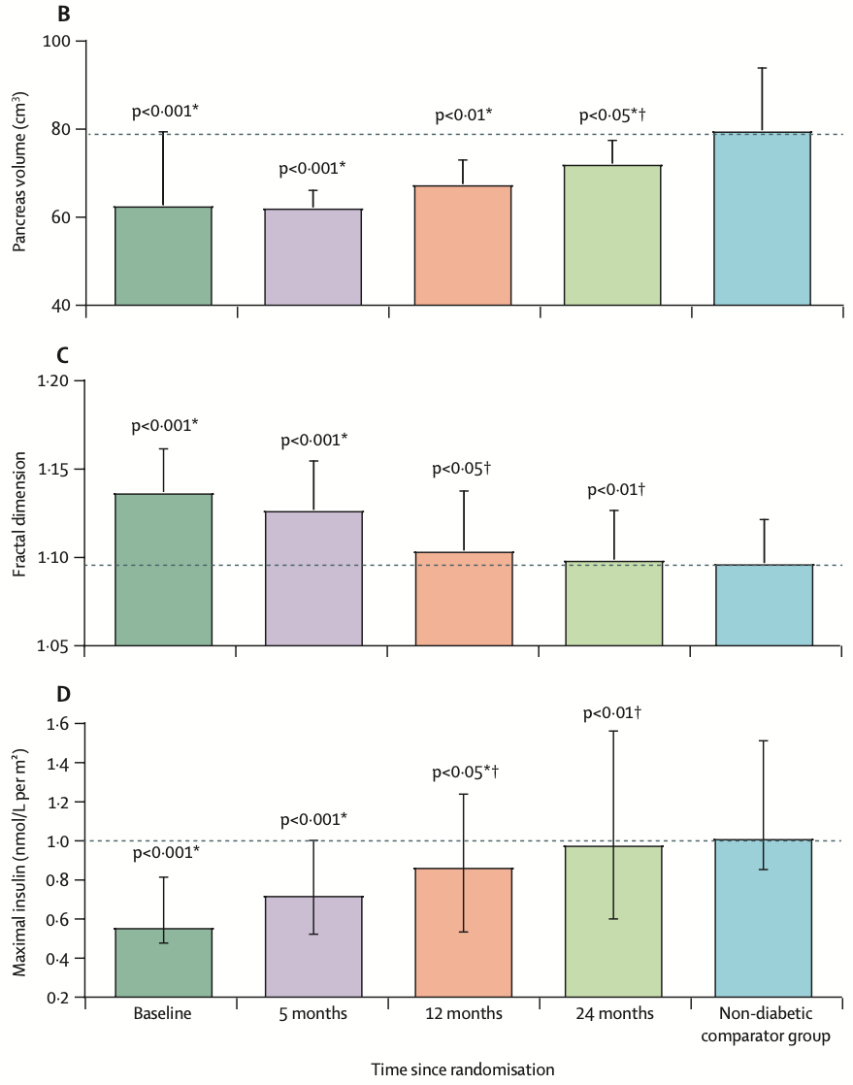
REMISSION MAY RESTORE BETA CELL FUNCTION
Pancreatic volume is typically 30% lower in T2D
After 24 months of remission
  Near normal pancreatic volume
  Restoration of maximal insulin secretion
Implications
Beta cell function loss may be reversible
Restoration of function may require 2+ years of remission
Al-Mrabeh A, et al. The Lancet Diabetes & Endocrinology. October 2020

Slide 9
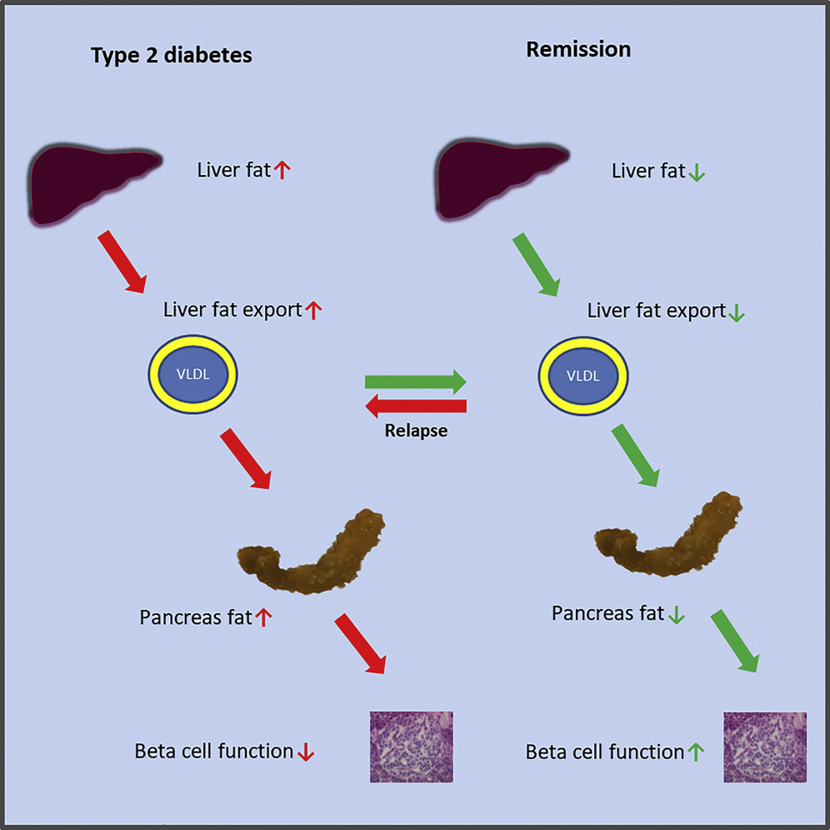
REMISSION MECHANISM
Steps to Remission:
Decrease liver fat
Decrease fat export from liver
Decrease pancreatic fat
Improve beta cell function
Recurrence of diabetes occurs when this process is reversed
REMISSION IS REVERSIBLE
Al-Mrabeh Aet al. Cell Metabolism 2020;31(2):233-249.e4.

Slide 10
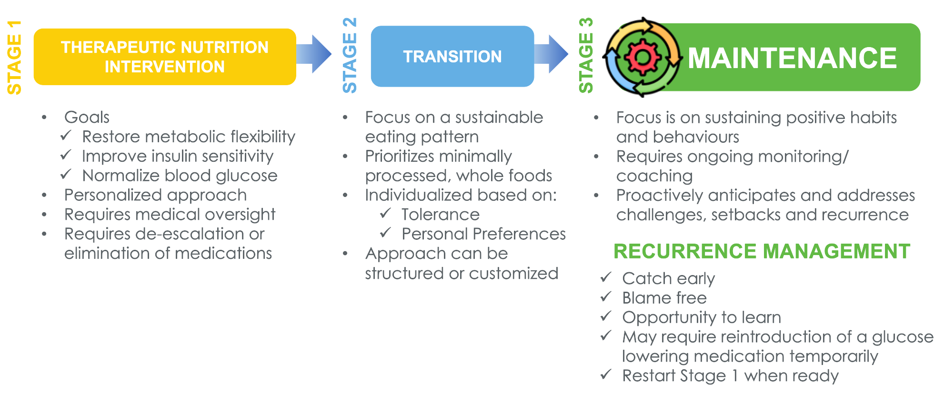
THE JOURNEY TO TYPE 2 DIABETES REMISSION

Slide 11


DIABETES REMISSION RESOURCES
Launched December 2022
Includes:
  24-page eBook
  Readiness checklist
  Prescription for Better Blood Sugar infographic
  Q&A
  Success Stories
  Letter to HCP
Included as a resource on the BC Pathways website
www.diabetesremission.ca

Slide 12
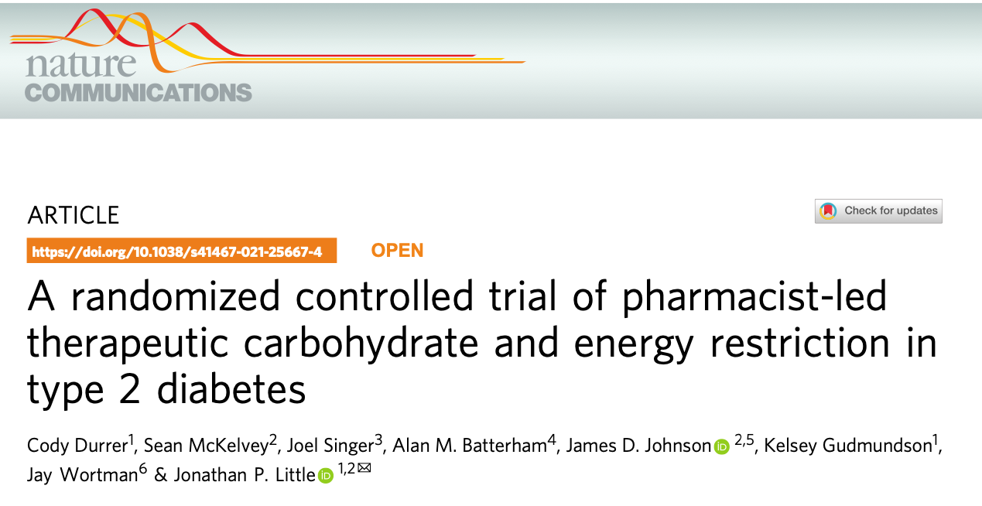
UBC/IPTN PHARM-TCR STUDY
Sept 10, 2021

Slide 13
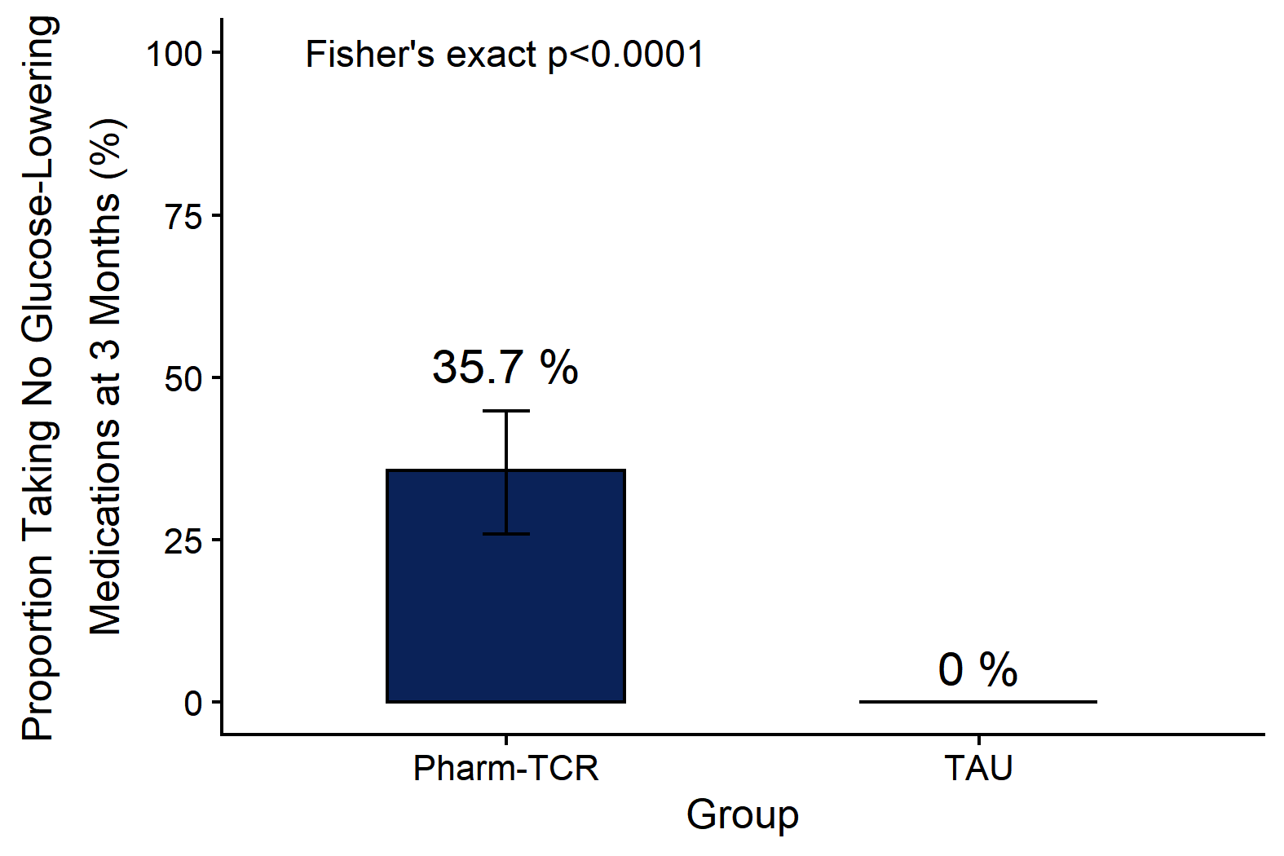
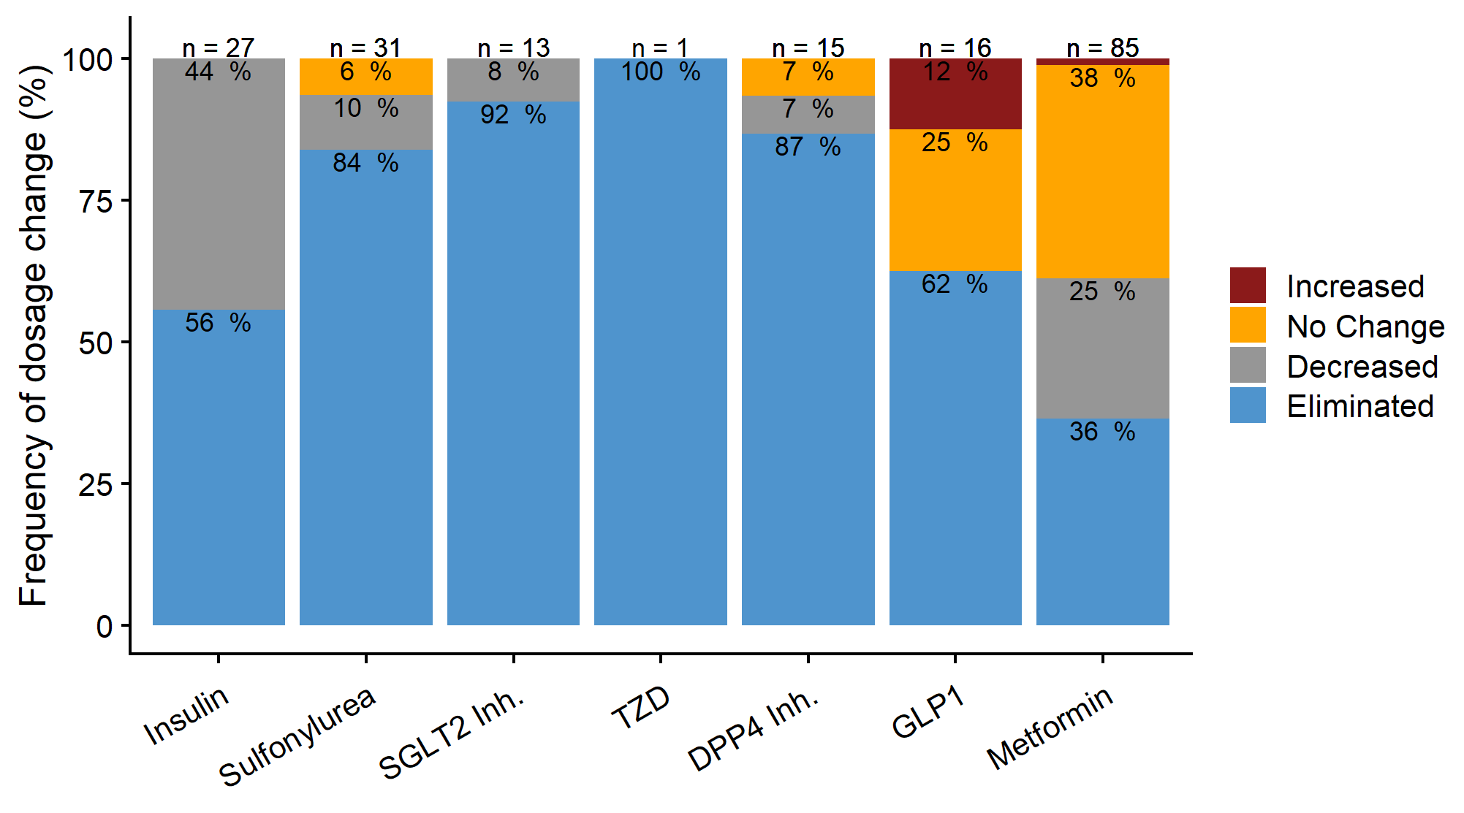
PHARM-TCR OUTCOMES
PRIMARY OUTCOME
SECONDARY OUTCOME
Durrer C et al.. Nat Commun. 2021;12(1):5367

Slide 14
GLUCOSE LOWERING MEDICATIONS
Durrer C et al.. Nat Commun. 2021;12(1):5367

Slide 15
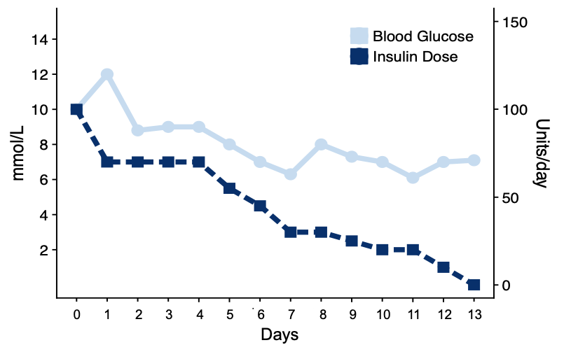
INSULIN DEPRESCRIBING

Slide 16
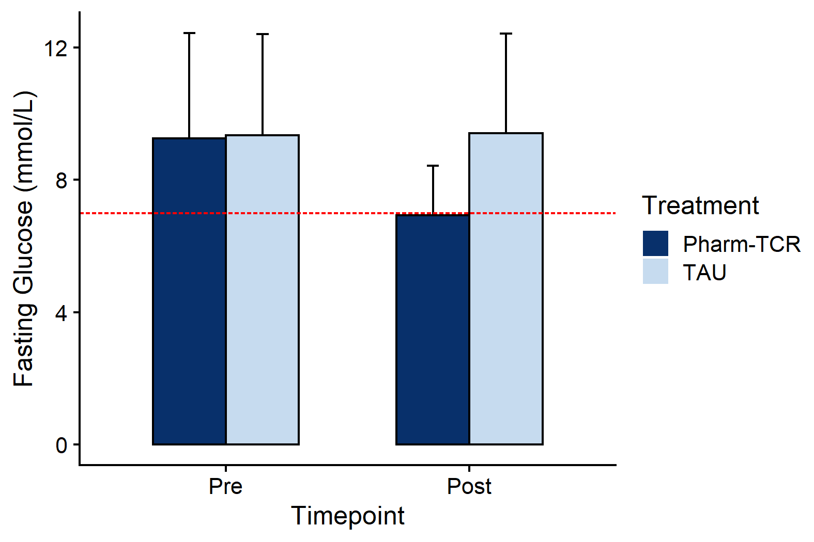
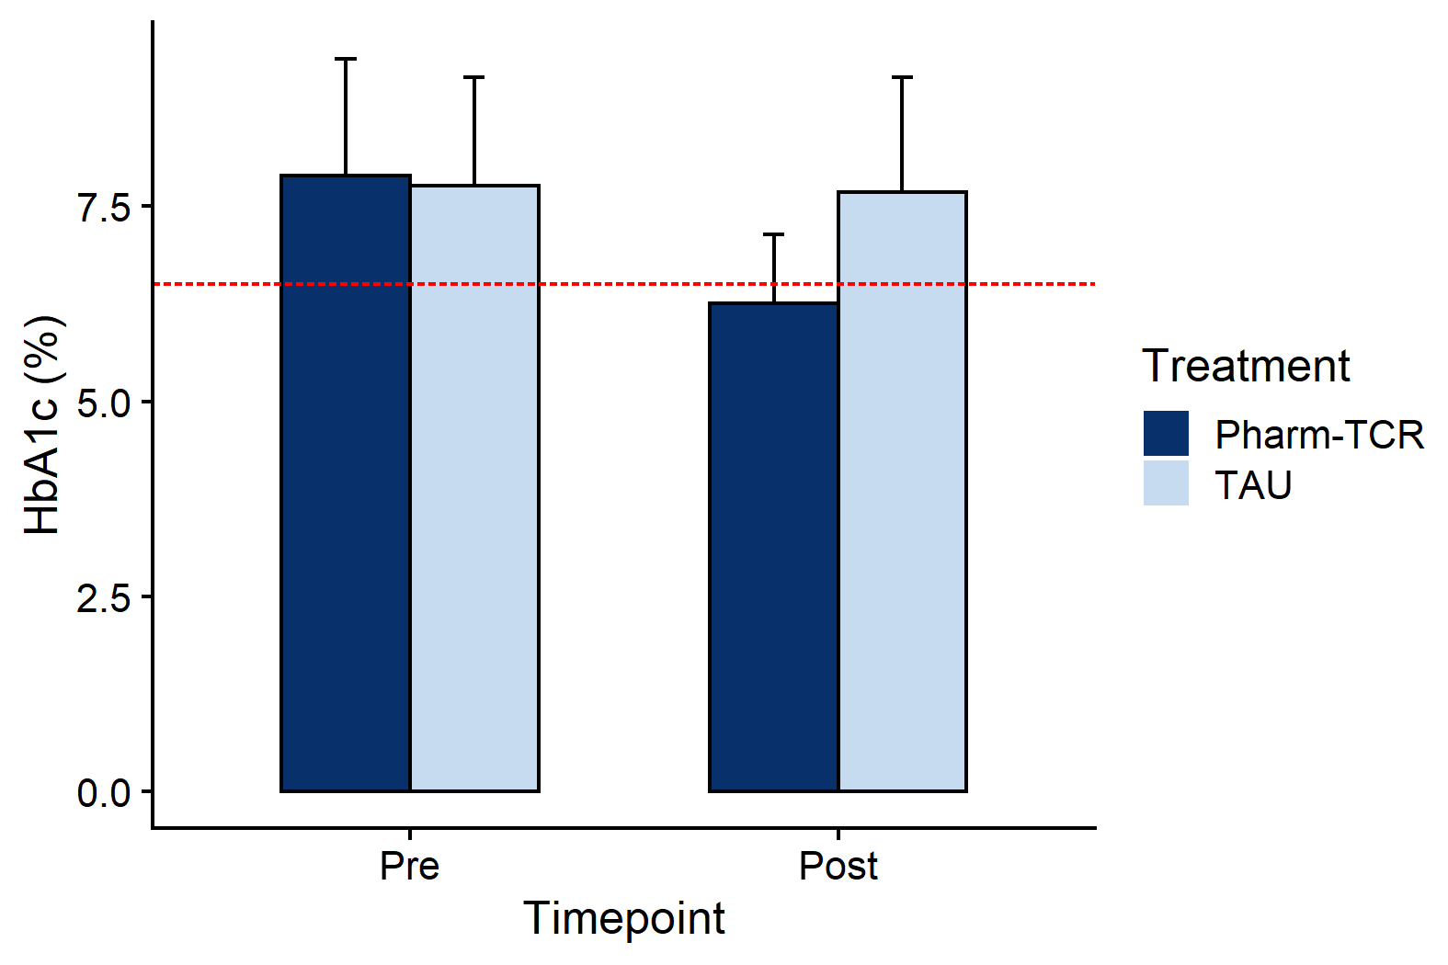
SECONDARY OUTCOMES – HBA1C & FASTING GLUCOSE
HbA1c
FPG
*
*
↓1.7%
↓2.5 mM
*p<0.001, Treatment effect, cLDA mixed effect model

Slide 17
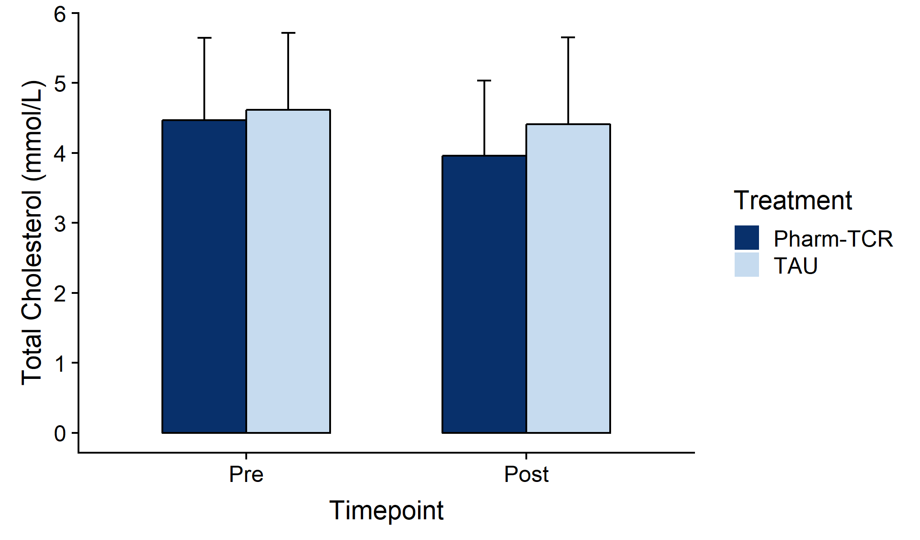
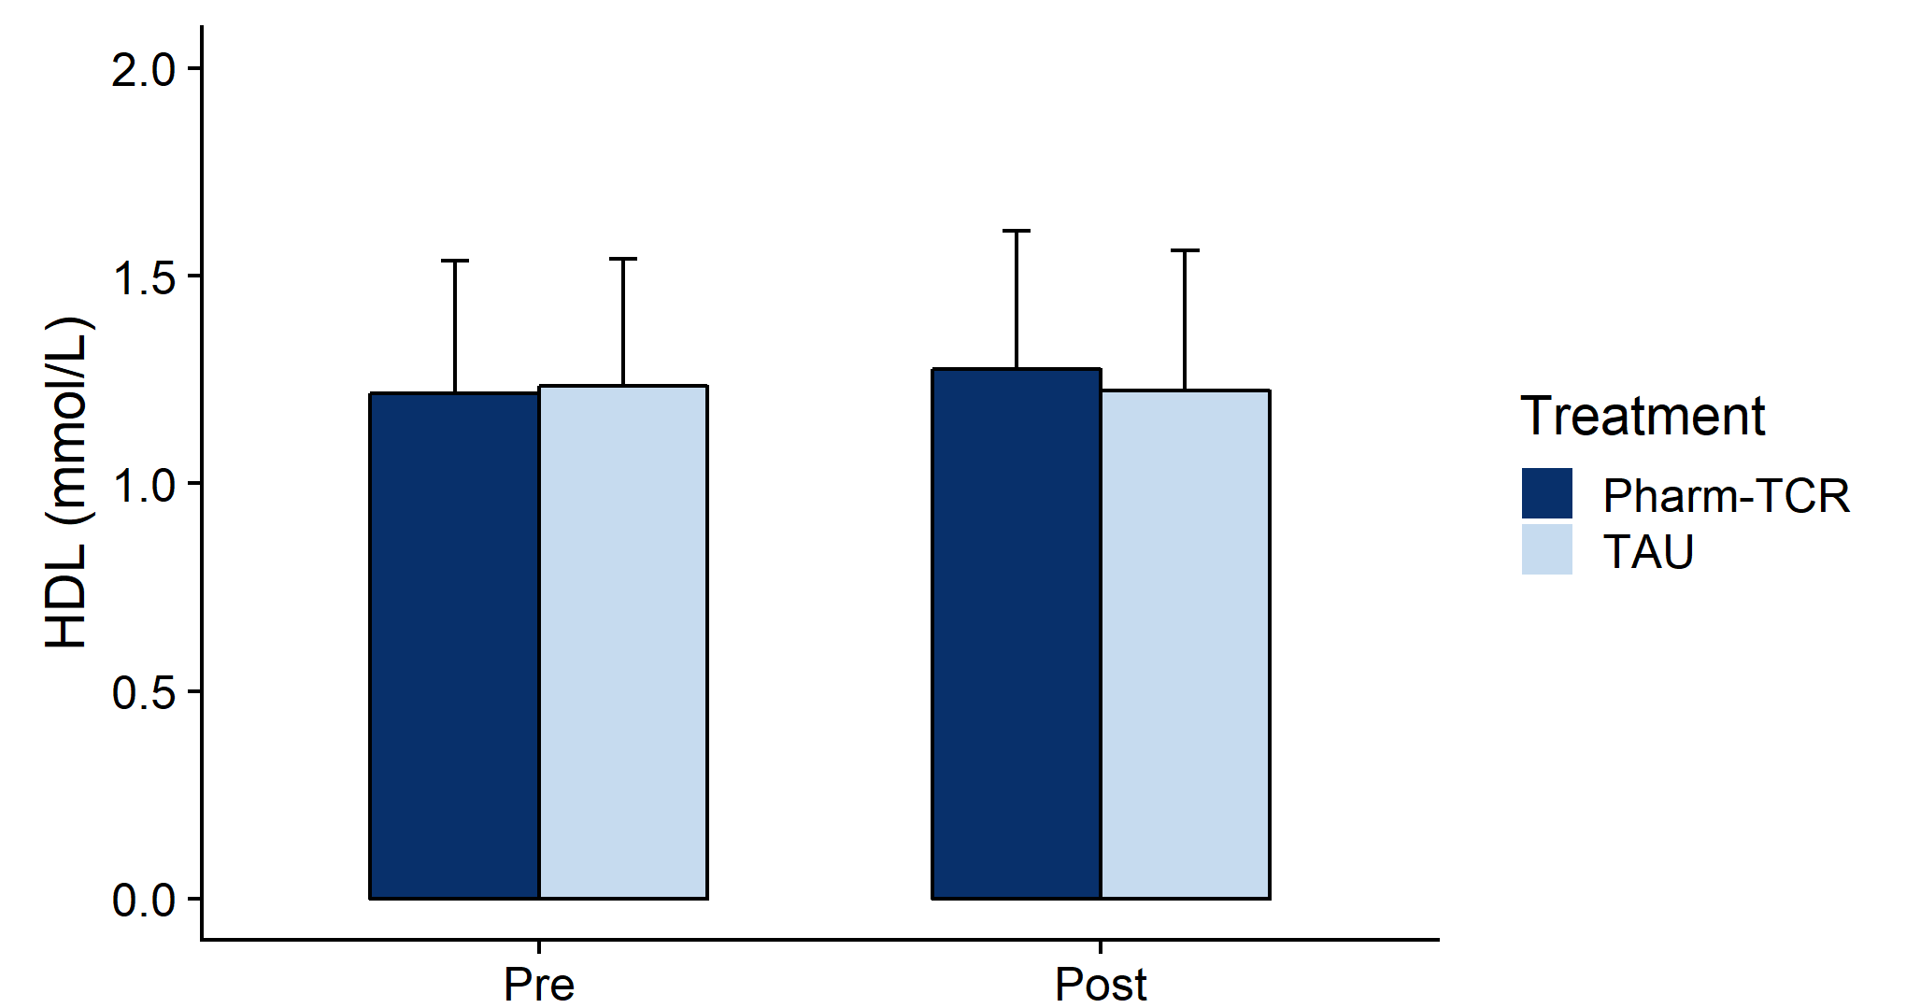
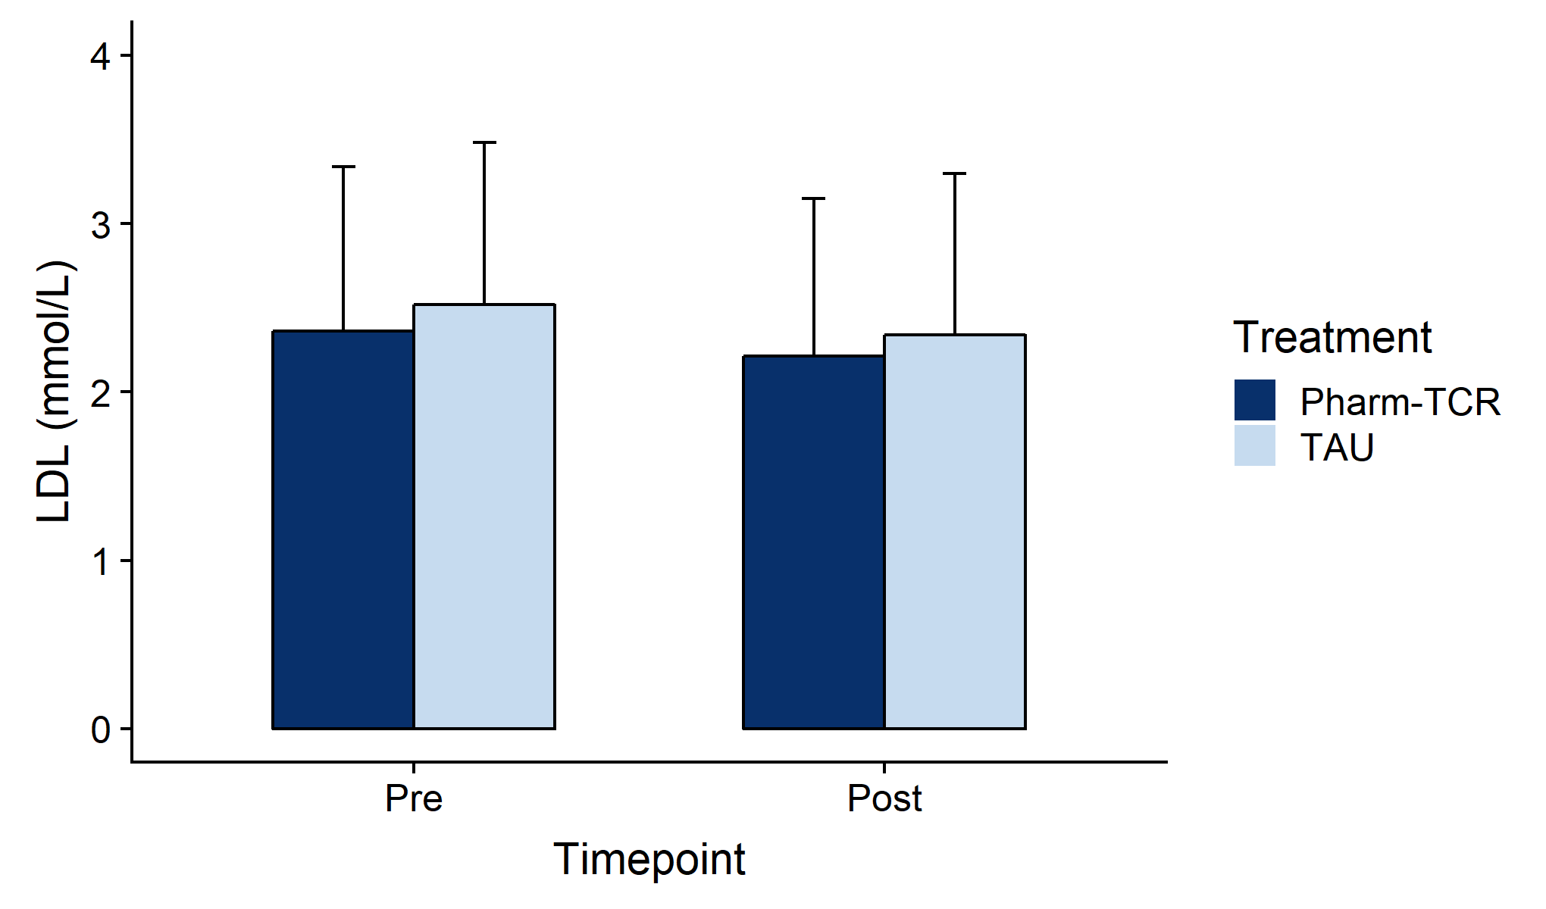
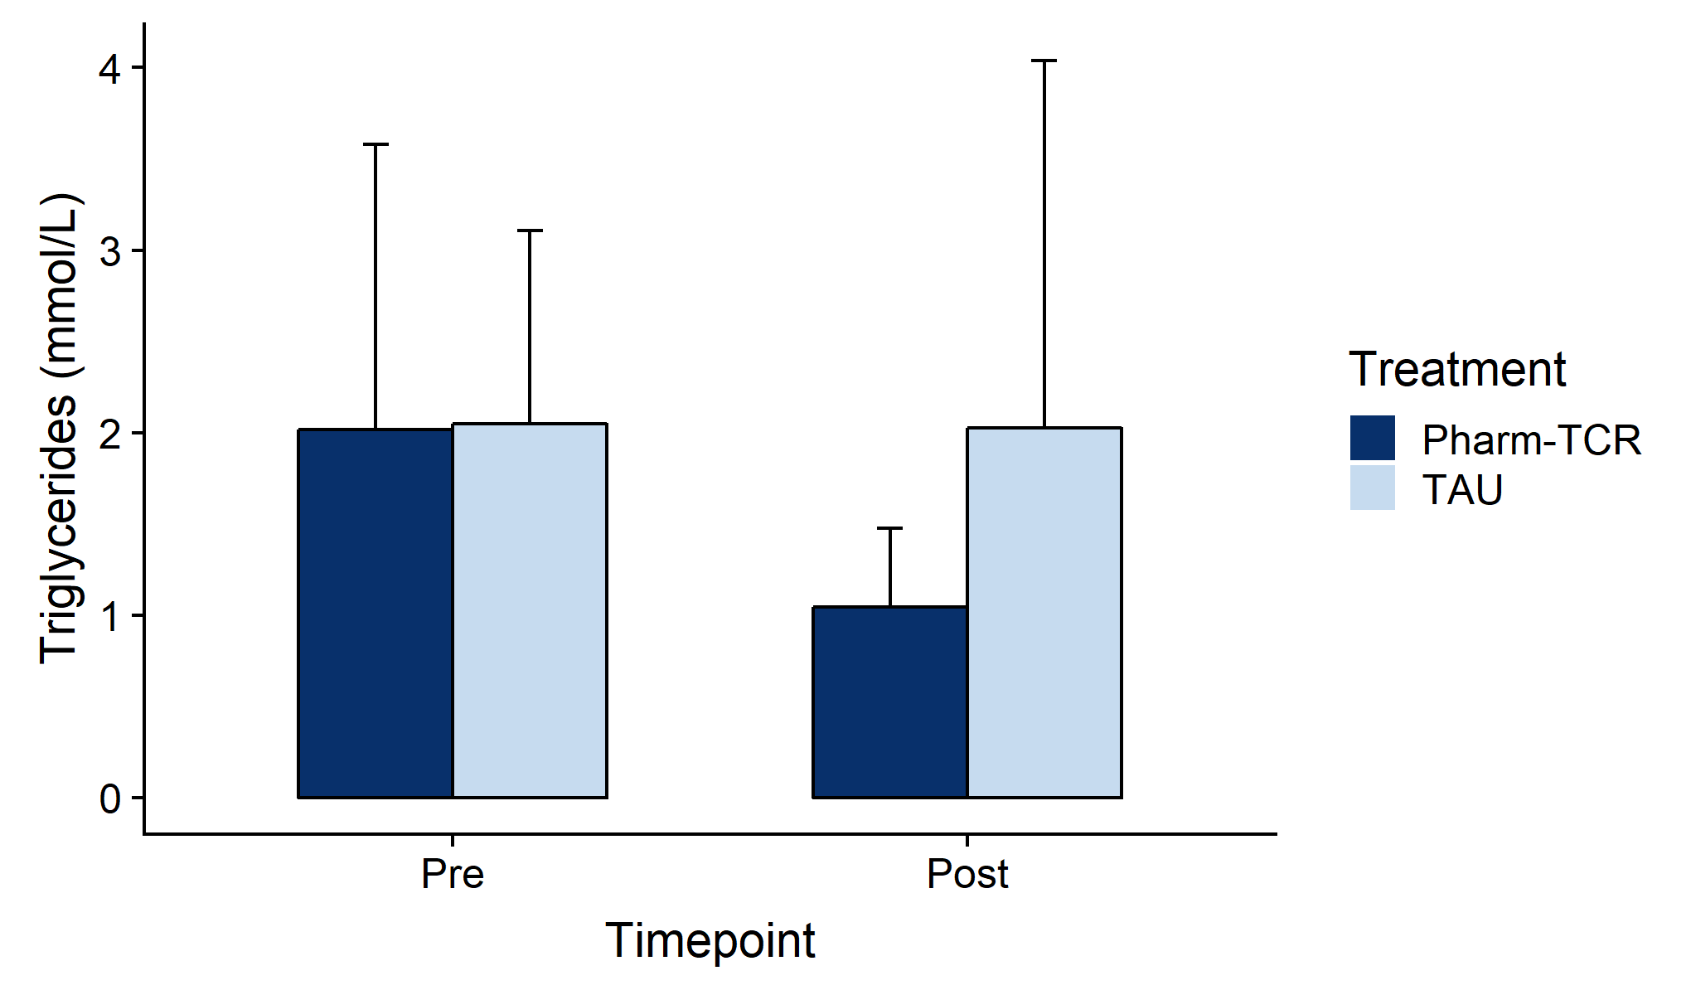
SECONDARY OUTCOME – BLOOD LIPIDS
Total Cholesterol
HDL
*
↓11%
LDL
TG
*
↓48%

Slide 18
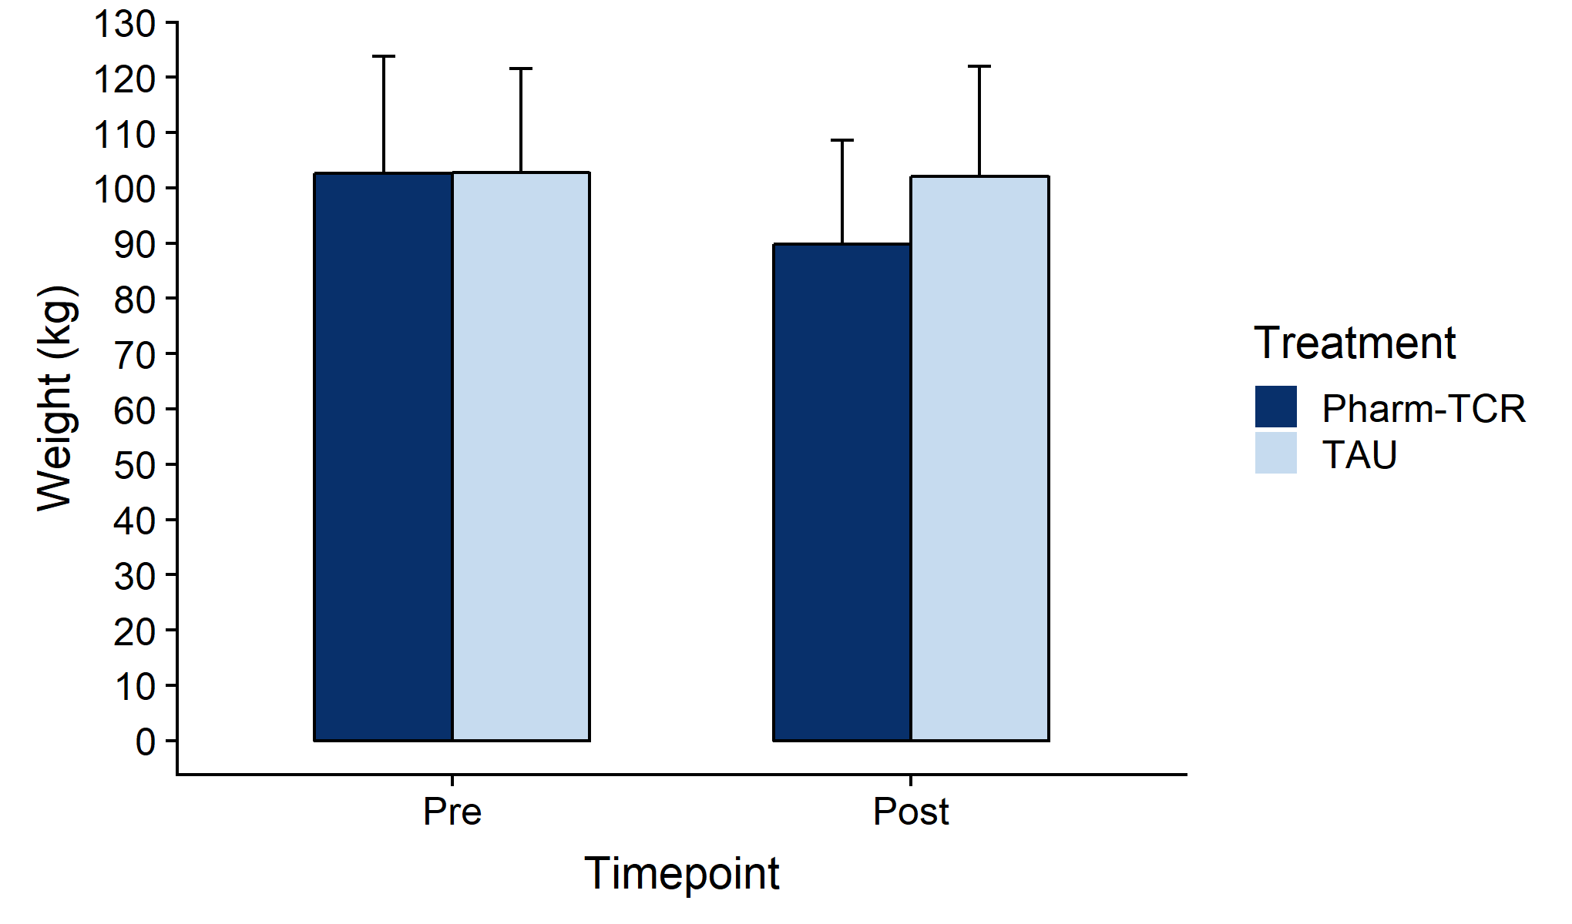
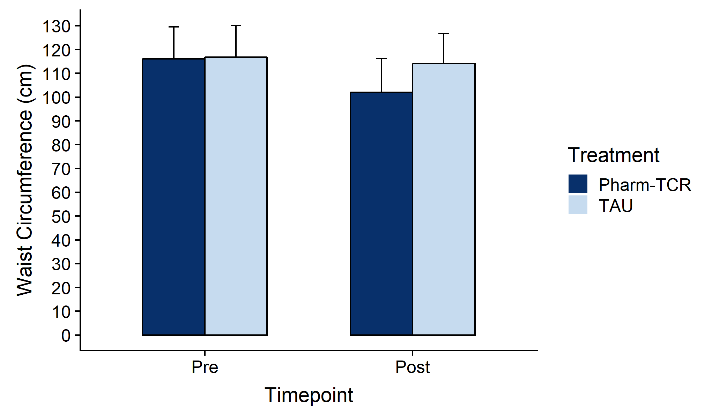
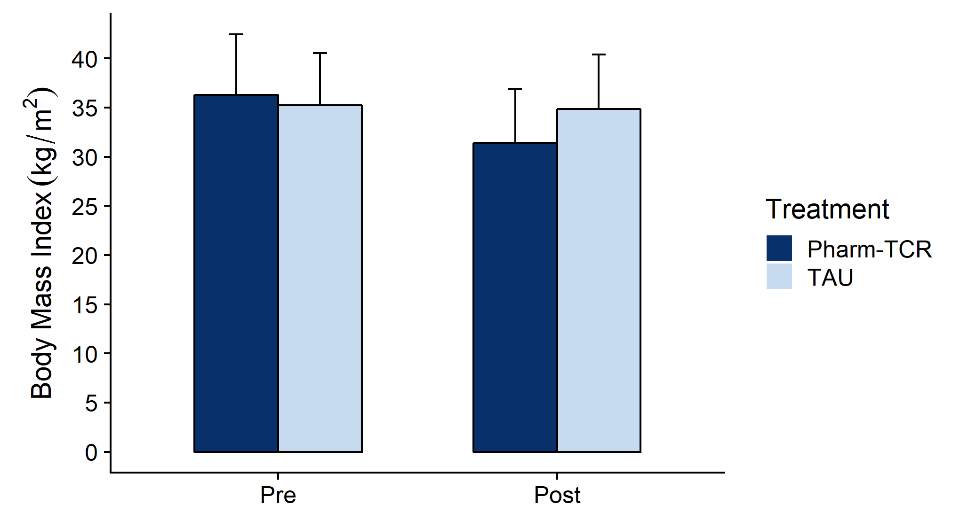
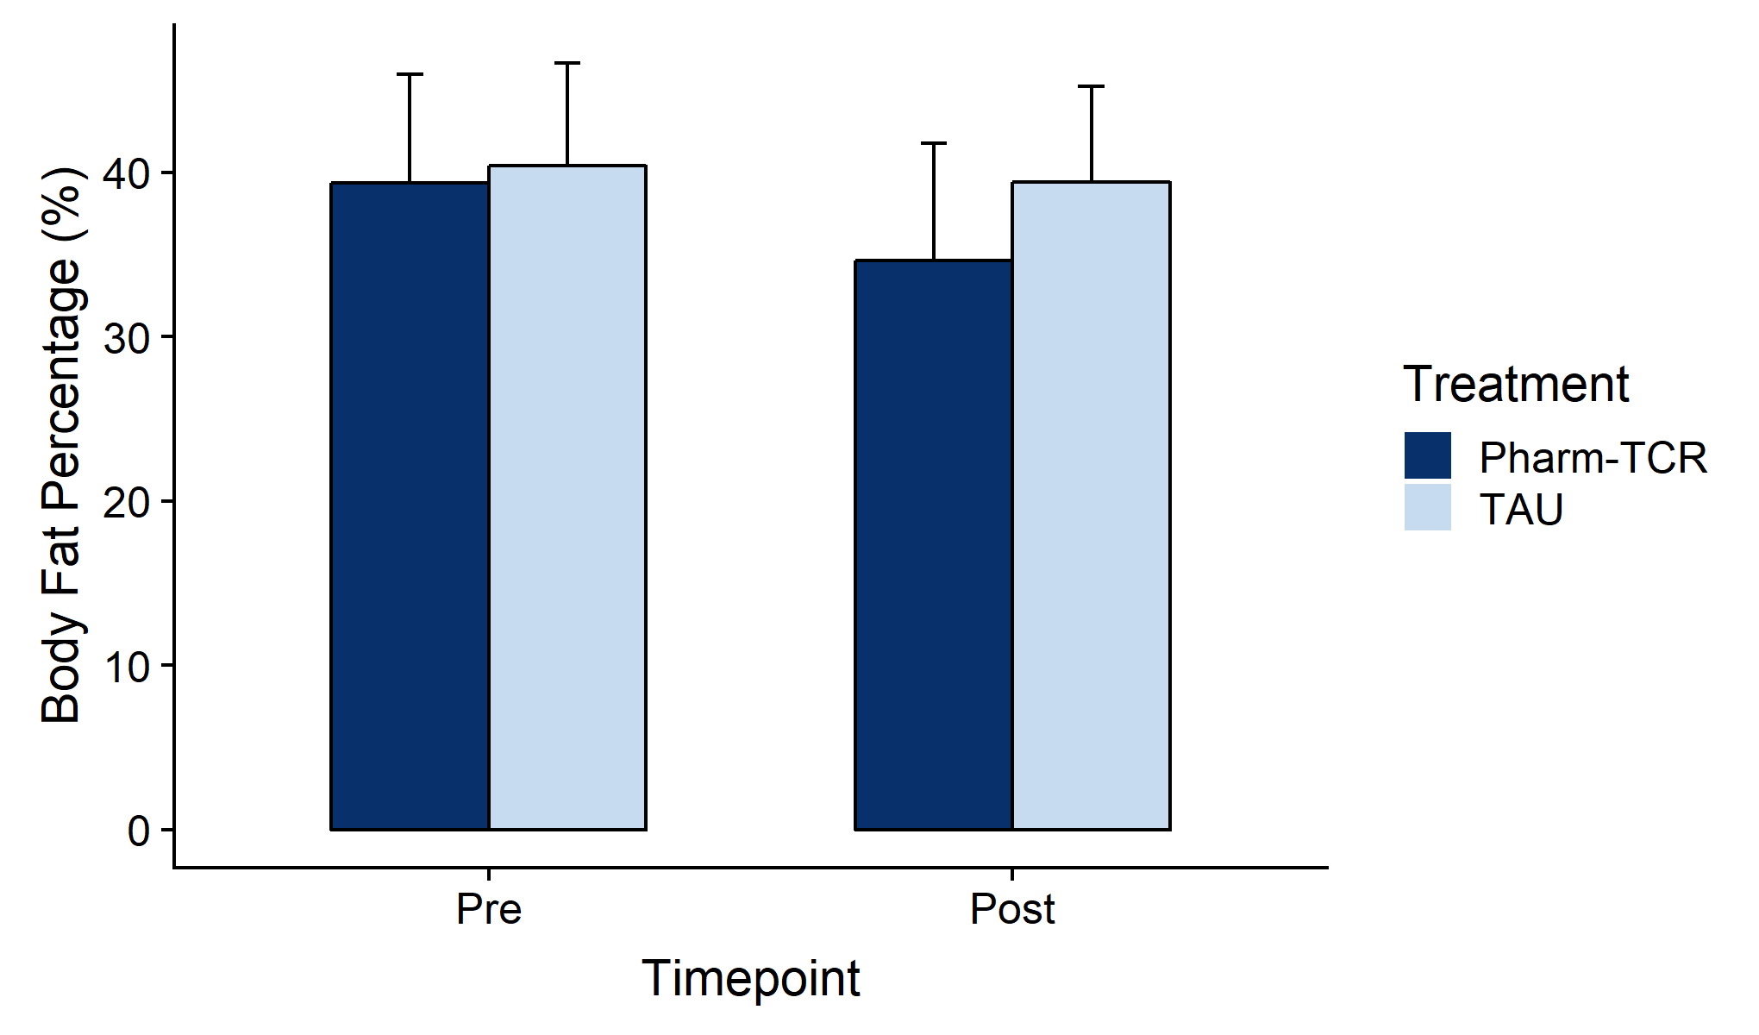
SECONDARY OUTCOME – ANTHROPOMETRICS
Weight
Waist Circumference
*
*
↓13 kg
↓14 cm
BMI
Body Fat %
*
*
↓5 kg/m²
↓5%

Slide 19
WHAT DOES THIS STUDY ADD?
Combined very low-carbohydrate + very low-calorie is efficacious for reducing medications while improving glucose control
Community pharmacists can play a key role in medication management for T2D treatment or remission interventions – an innovative & scalable approach
T2D might still be “reversible” in patients on insulin & in patients with longer duration T2D

Slide 20

Medication
Safety & Deprescribing

Slide 21
SAFETY FIRST
Blood glucose and blood pressure can drop quickly with very low carbohydrate and very low-calorie diets
Must act proactively to prevent predictable medication related adverse events
Biggest concerns are insulin, sulfonylureas and SGLT2i
“If you plan on changing your diet before the next time you see me, please contact us before you start because we may need to adjust your medications”

Slide 22
THERAPEUTIC CONSIDERATIONS
Is the patient able to monitor their blood glucose?
Do they know how to treat a hypoglycemic incident?
Have you considered the patient's wishes and preferences (i.e. shared decision making)
Is a medication being used to treat another medical condition?
On a complex regimen which medication(s) do you start with?
What is the monitoring plan, who is the patient contact and what will trigger additional medication adjustments?
Have you proactively identified and addressed common issues with the preferred dietary option (i.e. hydration, electrolytes etc.)

Slide 23
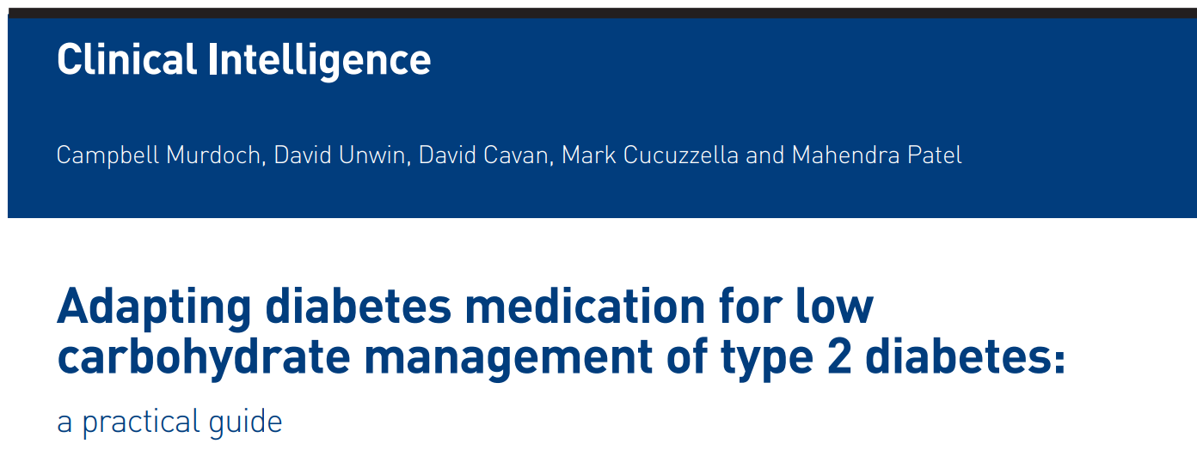
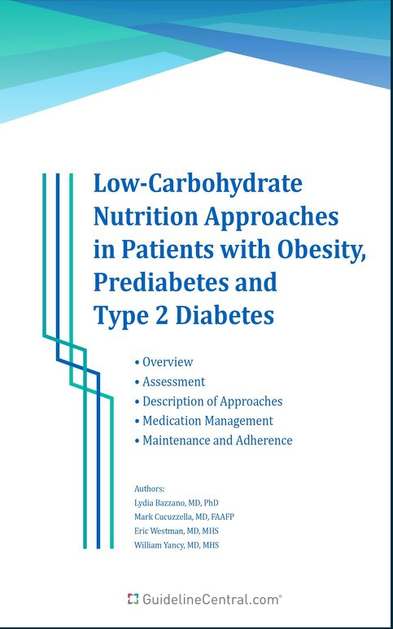
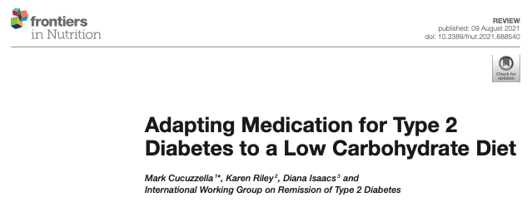
MEDICATION ADJUSTMENTS IN THE LITERATURE
Murdoch C et al, Br J Gen Pract. 2019;69(684):360-361
Aug 9, 2021
Cucuzzella et al Front Nutr. 2021;8:688540

Slide 24



MEDICATION DEPRESCRIBING - (VLCKD & LED/VLED)
Sulfonylureas
Meglitinides
Bolus insulin
SGLT2i (↑ risk of eDKA)
Combination insulins (30/70) - switch to basal
Alpha-glucosidase inhibitors
Basal insulins – may need to reduce dose by up to 50%
TZDs (weight gain)
Metformin
GLP-1 Analogs
DPP-4 inhibitors
Cucuzzella et al Front Nutr. 2021;8:688540

Slide 25
TIMELINES, TARGETS AND MONITORING
Very low carbohydrate and/or very low-calorie intake can cause rapid drop in blood glucose in first 4 to 7 days
Must be prepared to adjust medications quickly or risk hypoglycemia
Recommend BG of 7-11mmol/L during medication adjustments
Clients will need to monitor BG daily or use CGM until stable
Regular follow-up and communication is required
  Daily recommended while on hypoglycemics
  Weekly if only on Metformin

Slide 26
DEPRESCRIBING STRATEGY
There is no ‘one-size-fits all’ approach
Address ‘red light’ issues first, focussing on oral agents and insulin
Additional adjustments are made based on glycemic response
Remember – you can always add it back
Initial Changes
Ongoing Changes
If uncontrolled, you can hold. If well controlled, then changes can be bold
If higher than 8, changes can wait. If lower than 6, it’s time to fix!

Slide 27
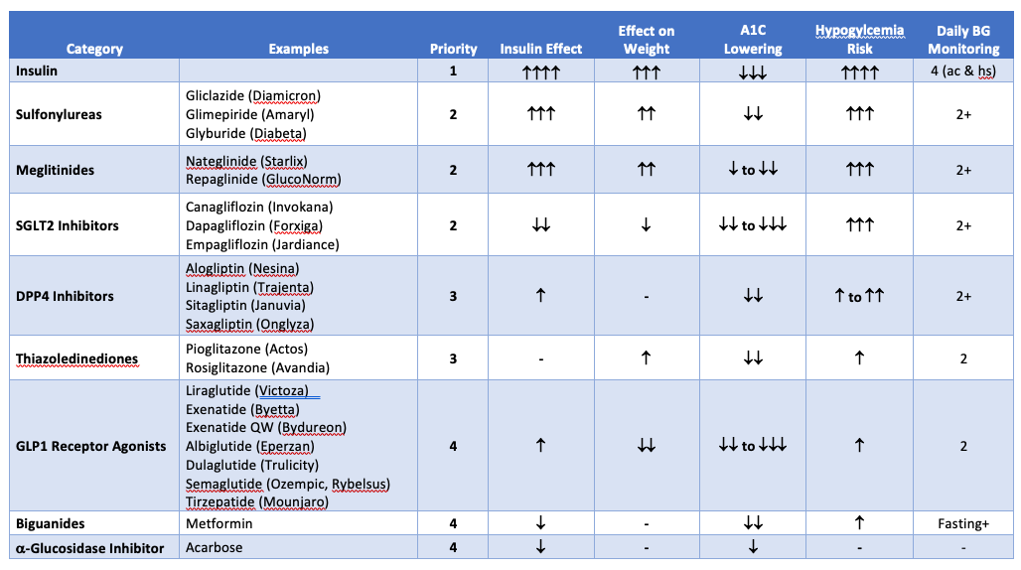
HYPOGLYCEMIC DEPRESCRIBING

Slide 28
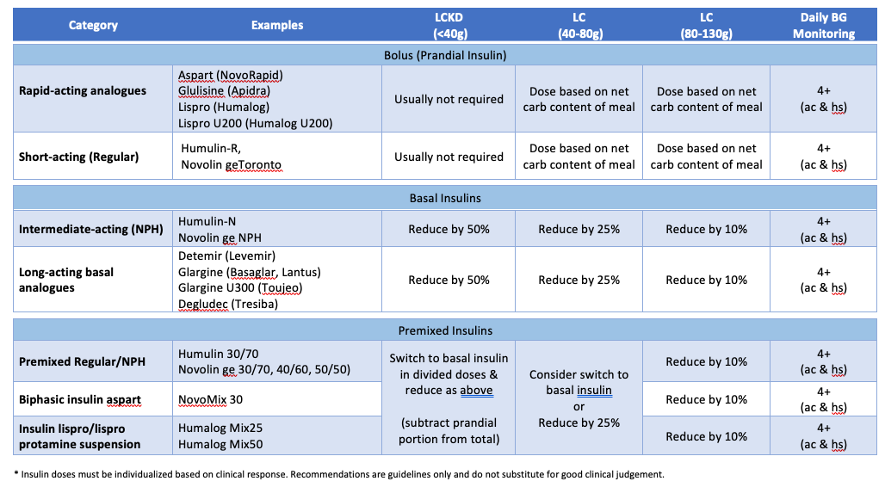
INSULIN DEPRESCRIBING – DAY 1

Slide 29
CLINICAL MANAGEMENT
Before stopping insulin, it is important to rule out insulin insufficiency (i.e. LADA)
  Affects from 2% to12% of those diagnosed with type 2 diabetes
  Checking c-peptide levels before stopping insulin is warranted
Patient may not be a good candidate for remission if they:
  Are not able to self-monitor blood glucose
  Have a history of eating disorders or significant mental health disorders
  Are currently being treated for cardiovascular or kidney disease
A1C should be monitored every six months for those achieving remission
Diabetes 2020;69:2037–2047
https://guidelines.diabetes.ca/cpg/special-article-remission-of-type-2-diabetes

Slide 30
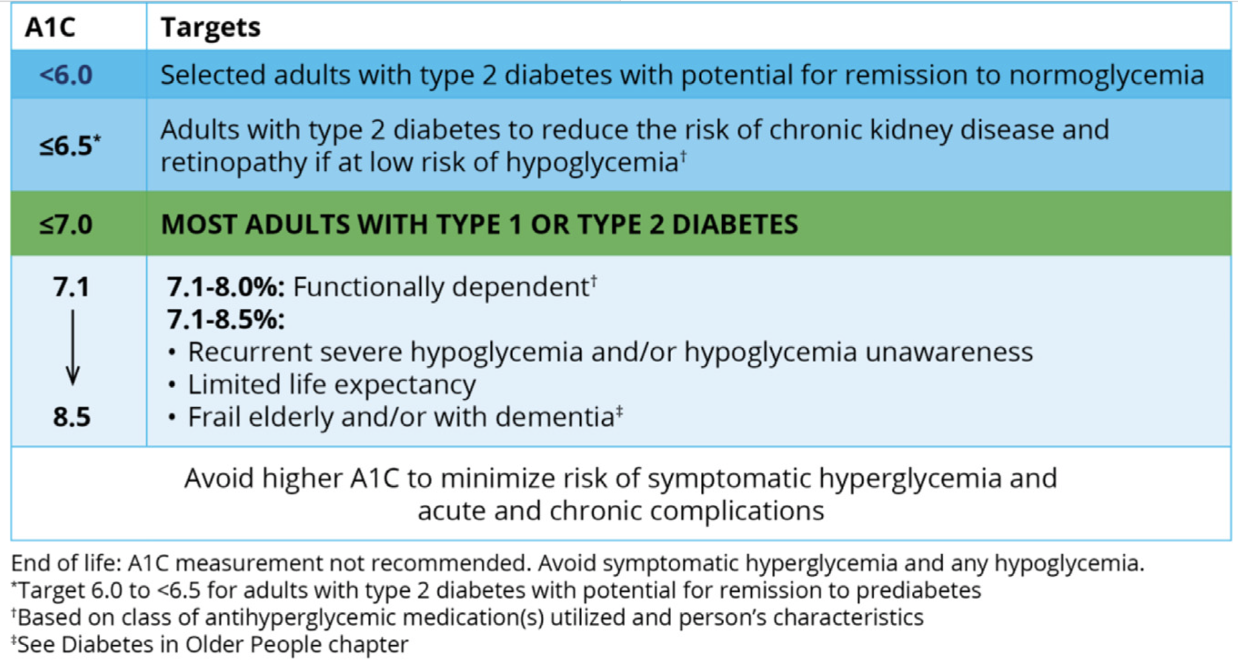
A1C TARGETS NOW INCLUDE REMISSION
https://guidelines.diabetes.ca/cpg/special-article-remission-of-type-2-diabetes

Slide 31
MEDICATION RE-INTRODUCTION
Recurrence of type 2 diabetes is NORMAL and to be expected
Reinforce that restarting medications is NOT a ‘failure’.
  You are working to protect blood vessels and organs until they are ready to try again
  Good to remind them that not everyone needs to be in remission to benefit from ongoing lifestyle changes
Where possible, avoid medications that increase insulin and/or cause weight gain (i.e. sulfonylureas, insulin, TZDs)
GLP-1 receptor agonists (and SGLT2i’s) may be considered for weight control and cardiorenal protection

Slide 32
WHAT WE DON’T KNOW
Which patients will be interested/motivated to pursue remission?
What percentage of people will achieve remission in the ‘real world’?
What percentage of people will maintain remission for 5+ years?
Will remission reduce diabetes related complications in the future?
What dietary interventions will work best for achieving remission at different stages of type 2 diabetes?
What is the optimal care model for supporting maintenance of remission?
How many health professionals in primary care will offer remission services?

Slide 33
WRAP UP
Remission is a viable option for up to 50% of patients with type 2 diabetes, who choose to pursue it
The sooner they are informed about remission the more likely they will be able to achieve it
Recurrence is to be expected and must be planned for
Requires medical supervision to prevent predictable and preventable medication related adverse events
Resources and training exist to assist health professionals with medication deprescribing
Every patient has a right to know that remission is possible and be supported in their pursuit of better health

Slide 35
REFERENCES – DIABETES REMISSION
Lean MEJ, Leslie WS, Barnes AC, et al. Durability of a primary care-led weight-management intervention for remission of type 2 diabetes: 2-year results of the DiRECT open-label, cluster-randomised trial. The Lancet Diabetes & Endocrinology. March 2019. doi:10.1016/S2213-8587(19)30068-3
Athinarayanan SJ, Adams RN, Hallberg SJ, et al. Long-Term Effects of a Novel Continuous Remote Care Intervention Including Nutritional Ketosis for the Management of Type 2 Diabetes: A 2-Year Non-randomized Clinical Trial. Front Endocrinol. 2019;10:348. doi:10.3389/fendo.2019.00348
Taheri S, Zaghloul H, Chagoury O, et al. Effect of intensive lifestyle intervention on bodyweight and glycaemia in early type 2 diabetes (DIADEM-I): an open-label, parallel-group, randomised controlled trial. The Lancet Diabetes & Endocrinology. 2020;8(6):477-489. doi:10.1016/S2213-8587(20)30117-0
Hocking SL, Markovic TP, Lee CMY, Picone TJ, Gudorf KE, Colagiuri S. Intensive Lifestyle Intervention for Remission of Early Type 2 Diabetes in Primary Care in Australia: DiRECT-Aus. Diabetes Care. Published online October 16, 2023:dc230781. doi:10.2337/dc23-0781
Durrer C, McKelvey S, Singer J, et al. A randomized controlled trial of pharmacist-led therapeutic carbohydrate and energy restriction in type 2 diabetes. Nat Commun. 2021;12(1):5367. doi:10.1038/s41467-021-25667-4
Dave R, Davis R, Davies JS. The impact of multiple lifestyle interventions on remission of type 2 diabetes mellitus within a clinical setting. Obesity Medicine. 2019;13:59-64. doi:10.1016/j.obmed.2019.01.005
Esposito K, Maiorino MI, Petrizzo M, Bellastella G, Giugliano D. The Effects of a Mediterranean Diet on the Need for Diabetes Drugs and Remission of Newly Diagnosed Type 2 Diabetes: Follow-up of a Randomized Trial. Diabetes Care. 2014;37(7):1824-1830. doi:10.2337/dc13-2899
Karter AJ, Nundy S, Parker MM, Moffet HH, Huang ES. Incidence of Remission in Adults With Type 2 Diabetes: The Diabetes & Aging Study. Diabetes Care. 2014;37(12):3188-3195. doi:10.2337/dc14-0874

